Slide 1


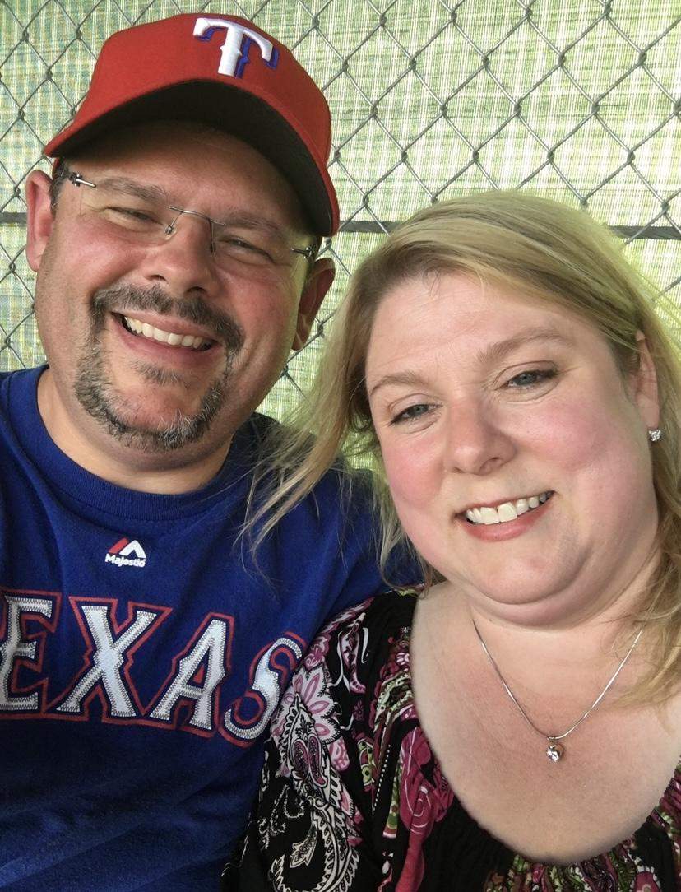
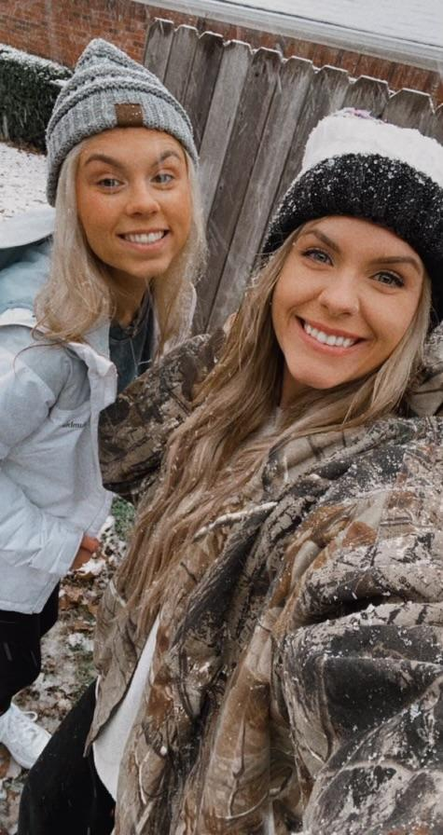
Meet Mrs. Petty
BIO: This is my 29th year as a teacher. I have a Masters degree in Curriculum and Instruction, a Masters degree in Reading, a Reading Specialist certification, and am a Legacy Master Reading teacher. I LOVE to learn and share what I learn with others.
FUN FACTS: I have two children: Tiffany (30) who loves all things health and fitness related and Kaylee (24) who was a 3-year drum major and is a 2020 graduate of Lindale ISD. She is a 2024 graduate of Texas A&M- College Station as well. I also have a loving husband who has been in educational administration for years and is a jeweler specializing in repairs and custom design.
PERSONAL MISSION STATEMENT: I feel I am blessed to be a blessing to others. I desire to love, equip, and train our next generation of leaders, to be a lifelong learner, and to make a positive difference in the lives of everyone I meet.

